Slide 1
INTERACTIVE NOTBOOK topic: STATISTICS class: teacher: Semester 2, Term 3

Slide 2
Contents
Glossary or Formula Page
Page
Date
Description
Word
Description
2
3

Slide 3
Tasks
24
7
30
Topic
Essential Question
Questions
Notes
Summary
8
9

Slide 4
24
7
30
Measuring the Spread of Data
Date
EQ – How do we measure the centre of the data?

Slide 5
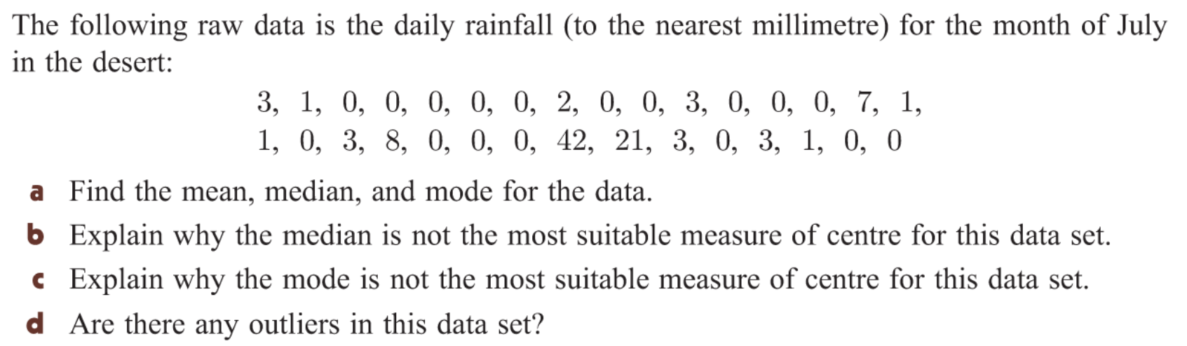
From Last Lesson

Slide 6
Activity
7 VOLUNTEERS to stand at the front of the room
(each volunteer to write a number between 1 – 30 on a post it note)
2) Volunteers stand from smallest number to largest.
Class – how would I work out the mean?
How would I work out the median?
Class – How would I work out the range?
Class – Are there any outliers?

Slide 7
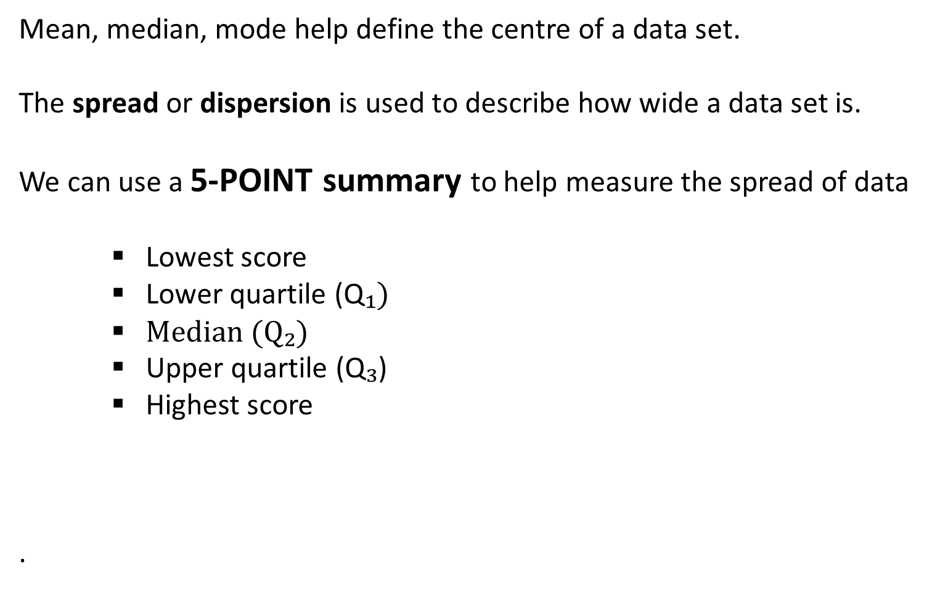
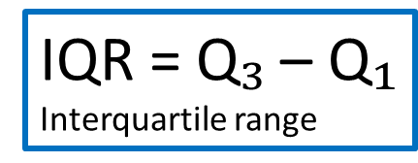
24
7
30
Measuring the Spread of Data
Date
EQ – How do we measure the centre of the data?
Mean, median, mode help define the centre of a data set.
The spread or dispersion is used to describe how wide a data set is.
We can use a 5-POINT summary to help measure the spread of data
Lowest score
Lower quartile (Q$₁)$
Median (Q₂)
Upper quartile (Q$₃$)
Highest score
.
Range = HS – LS
IQR = Q$₃$ – Q$₁$
Interquartile range

Slide 8
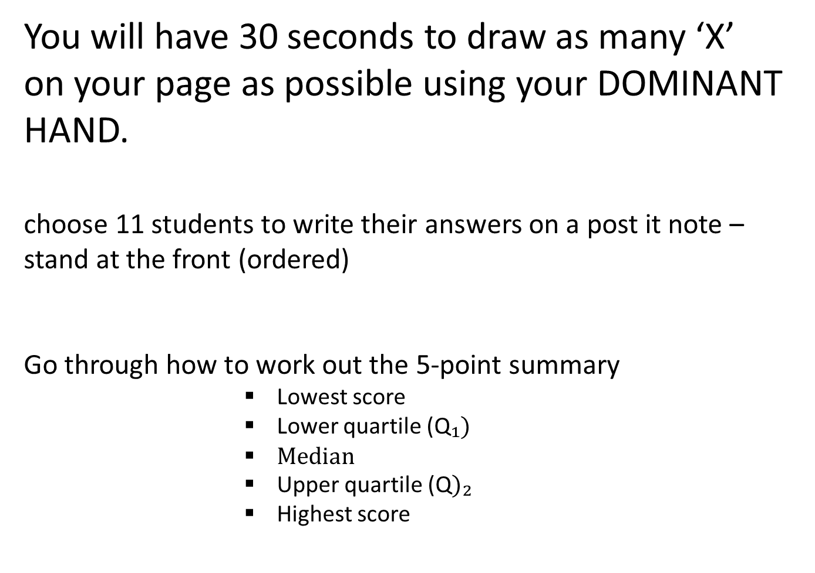
Activity
You will have 30 seconds to draw as many ‘X’ on your page as possible using your DOMINANT HAND.
choose 11 students to write their answers on a post it note – stand at the front (ordered)
Go through how to work out the 5-point summary
Lowest score
Lower quartile (Q$₁)$
Median
Upper quartile (Q$)₂$
Highest score
Notes:
REPEAT with left hand choose maybe an even number = 14 students?

Slide 9
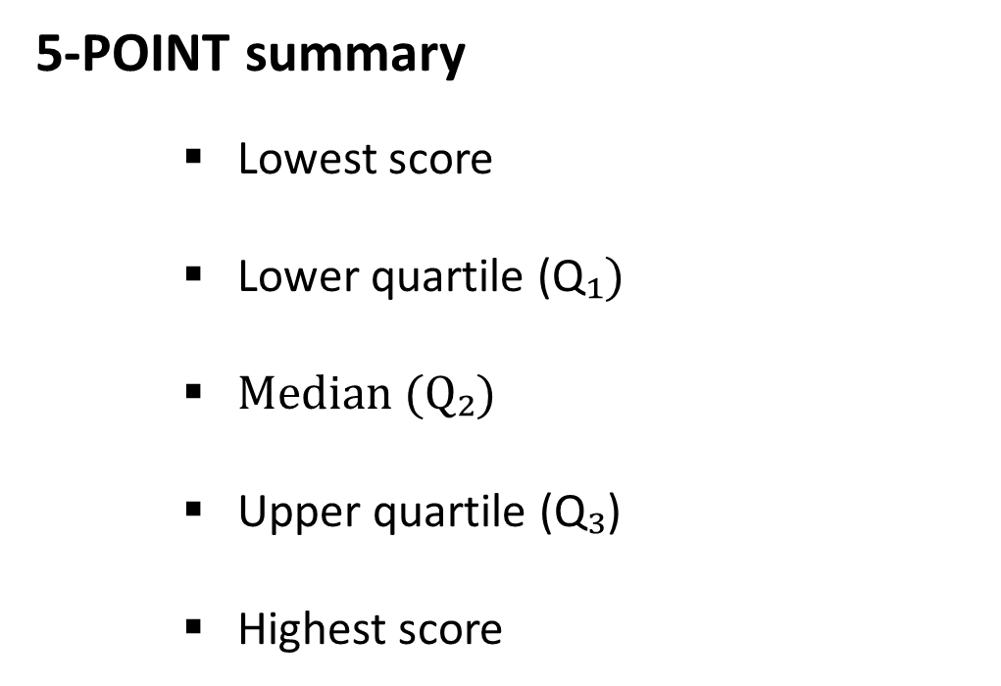
24
7
30
Measuring the Spread of Data
Date
EQ – How do we measure the centre of the data?
Example
4 , 5 , 6, 6, 7, 8, 9 , 10 , 10 , 11, 15, 18 , 20
5-POINT summary
Lowest score
Lower quartile (Q$₁)$
Median (Q₂)
Upper quartile (Q$₃$)
Highest score
Range =
IQR =
Interquartile range

Slide 10
Your turn

Slide 11
Task
Essential maths
Exercise 9J (page 554)
Q1)
Q2)
Q4)
Q5)

